Slide 1
Demo for Tool - “ToolRF”

Slide 2
Train Data
(Class=0,1)
Test Data
Response Column name
Output processed by Tool
Tool overview
Tool
Input:
Train Data = Already predicted data(Historic Data). With two type of class i.e. 0 or 1.
Response column name = The column of interest that represents prediction.
Test Data = Data to be predicted, scored and rules for prediction to be identified.
Tool performs standard steps of Data Science
Output:
Performance: Measure performance in terms of accuracy.
Most important variables: Most important column names responsible for predictions.
ID = The column of ID’s ( Can be Merchant ID, Customer ID etc.) in test data
Score = Probability of the prediction.
Rules = Column names and their values that are Highly responsible for the response for each ID.
Response = The class predicted for each ID ( e.g. 1 if it belongs to class BT Merchant, 0 if it is does not)
For Test Data :
ID
Response
Rules
Score
For Train Data:
Performance
Most Important variables for prediction

Slide 3

Dimensionality reduction

Slide 4
Row | Columns
125 | 120

Slide 5
Row | Columns
125 | 20
Row | Columns
125 | 60
Row | Columns
125 | 120
Row | Columns
125 | 2
Original Image
Row | Columns
125 | 1

Slide 6
X-Axis : Information Captured in %
Y-Axis : Accuracy on Test data
(Month 1379)
Information Captured in %

Slide 7
Imbalanced Data
Balanced Data
Columns | Response
….......... | 1
…........... | 1
…........... | 1
Columns | Response
….......... | 1
…........... | 1
…........... | 1
.
.
.
.
.
1
1
1
1
1
.
.
.
.
.
1
1
0
0
0
.…........
0
.…........
0
.…........
0
.…........
0

Slide 8
Dimensionality reduction
Balancing Data
Random Forest

Slide 9
Random Forest with 2 Decision Trees
TREE No.1: 2 Rules
TREE No. 2: 2 Rules
TPV_Growth
<=1.0
Take_rate <= 0.03
SOC <= 1.0
SOC <= 0.04
DCC <= 1
Response :0
Score : 0.67
EC <= 1
Take_rate <= 0.03
Response :1
Score : 0.56
1
1
2
3
2
3
4
5
4
5
Response : 0
Score : 0.65
Response : 1
Score : 0.54
6
Tree no. | Terminal Node No. | Rule | Response | Score
1 | 4 | TPV_Growth <= 1.0 & Take_rate > 0.03 | 0 | 0.65
1 | 5 | TPV_Growth > 1.0 & SOC <= 1.0 | 1 | 0.54
2 | 4 | SOC <= 0.04 & DCC <= 1 | 0 | 0.67
2 | 6 | SOC > 0.04 & EC <= 1 & Take_rate > 0.03 | 1 | 0.56
Non-Terminal Node
Terminal Node
Table 1

Slide 10
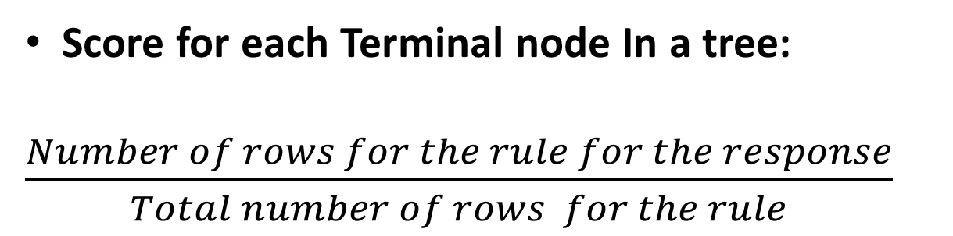
Score for each Terminal node In a tree:
$\frac{Number of rows for the rule for the response}{Total number of rows for the rule}$

Slide 11
Comp_cust_ID | TPV_Growth | Take_rate | SOC | DCC | EC
50000000XC. | 0.8 | 0.02 | 0.02 | 0 | 1
Input:
Predict(rf object, input) -> (response = 0)
Tree no. | Terminal Node No. | Rule | Response | Score
1 | 4 | TPV_Growth <= 1.0 & Take_rate > 0.03 | 0 | 0.65
1 | 5 | TPV_Growth > 1.0 & SOC <= 1.0 | 1 | 0.54
2 | 4 | SOC <= 0.04 & DCC <= 1 | 0 | 0.67
2 | 6 | SOC > 0.04 & EC <= 1 & Take_rate > 0.03 | 1 | 0.56
Tree No. | Terminal Node No. | Response | Score
1 | 4 | 0 | 0.65
2 | 4 | 0 | 0.67
Table 2
Table 1
Argmax(Score) { Get Rule from Table 1 matching CART No. and Terminal Node No. for maximum Score in Table 2}
(Rule)
Comp_Cust_ID | Response | Rule | Score
50000000XC. | 0 | SOC <= 0.04 & DCC <= 1 | 0.67
Output:

Slide 12
GitHub Link : https://github.paypal.com/dkatariya/Tool
File Name : ToolRF_1.0.tar.gz

